Slide 1
Exploratory Data Analysis
House sales - King County, Washington
06.11.2023 - Jonas Mortensen

Slide 2
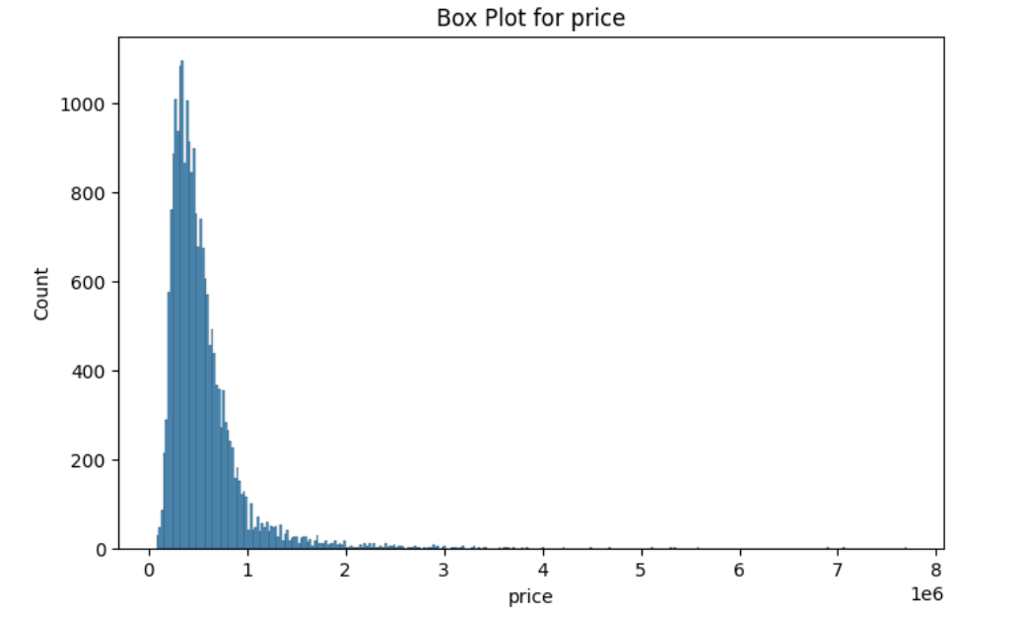
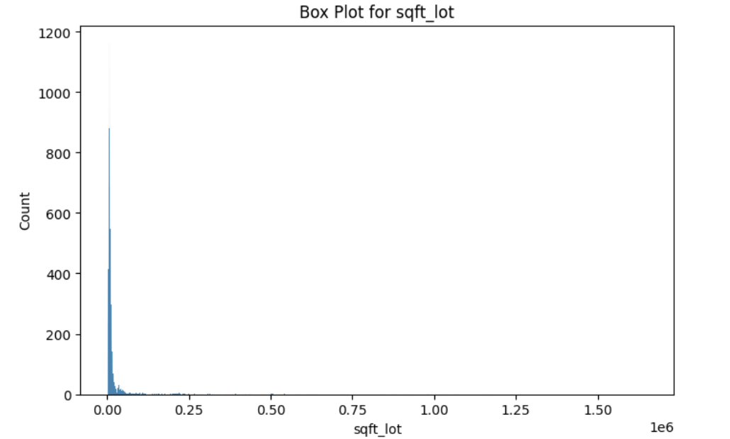
Based on the box plots and histograms we see outliers in: bedrooms, bathrooms, sqft_living, sqft_lot, sqft_above, sqft_living15, sqft_lot15, price
I will remove outlier for price and sqft_lot

Slide 3
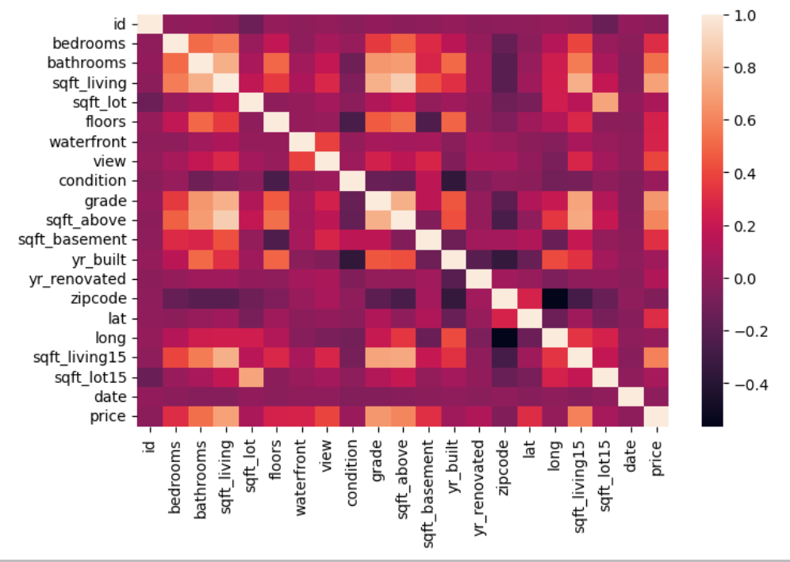
Price correlations
The correlation between sqft_living and price is: 0.70

Slide 4
Client
Two people, want a country house (best timing & non-renovated) & a city house (fast & central location).
William Rodriguez, Buyer

Slide 5
Hypothesis
House prices in a fast and central location is going to be significantly higher than a non-renovated house on the countryside

Slide 6
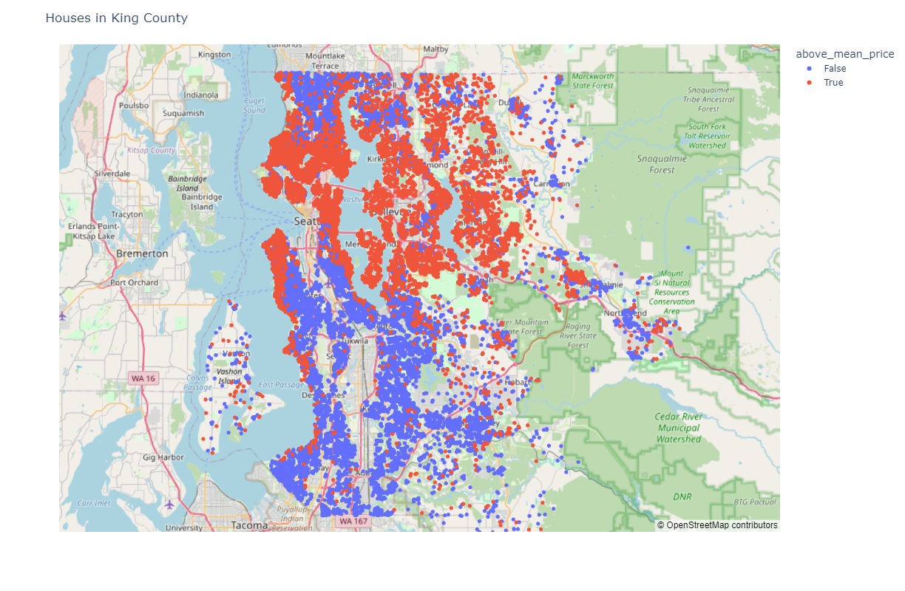
Above/below average house prices

Slide 7
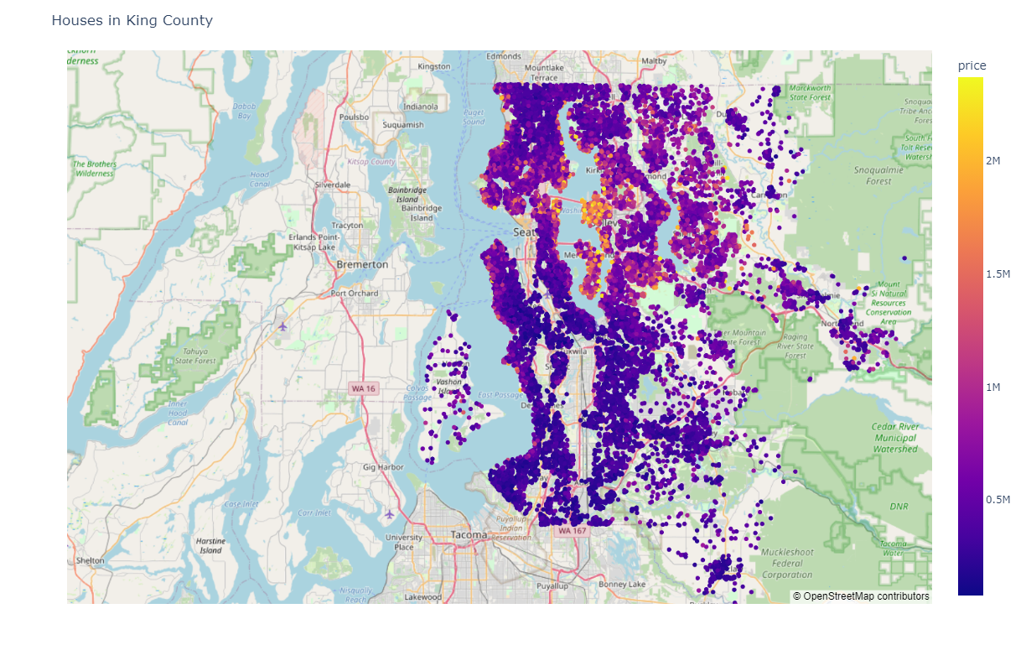
Heat map house prices (without outliers)

Slide 8
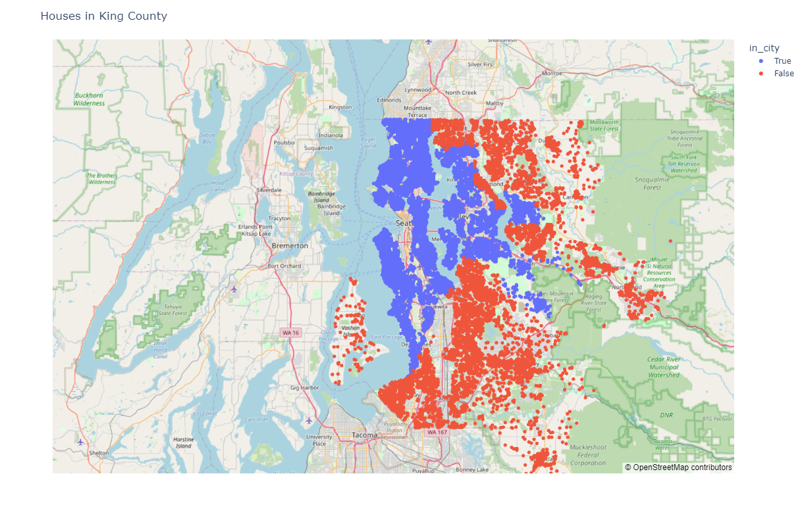
Dividing map into city zip codes and country zip codes

Slide 9
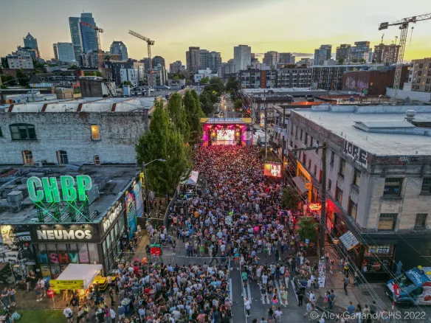
Capitol Hill, Queen Anne and Fremont in Seattle all live up to the client’s criteria in terms of fast and central location.

Slide 10
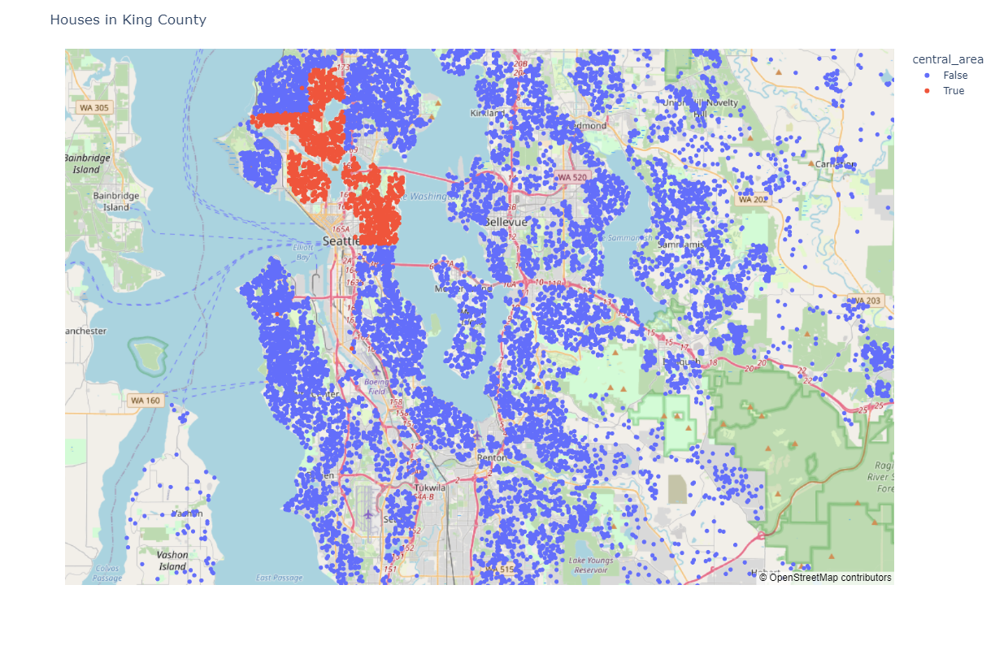
Capitol Hill, Queen Anne & Fremont

Slide 11
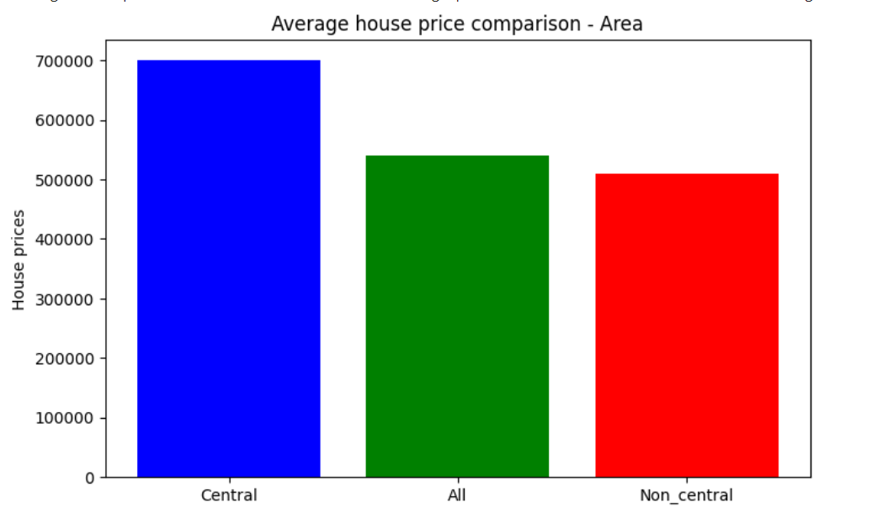
Comparison of avg. price in central vs. non-central area
House prices in our central locations are 37% higher than non-central areas.

Slide 12
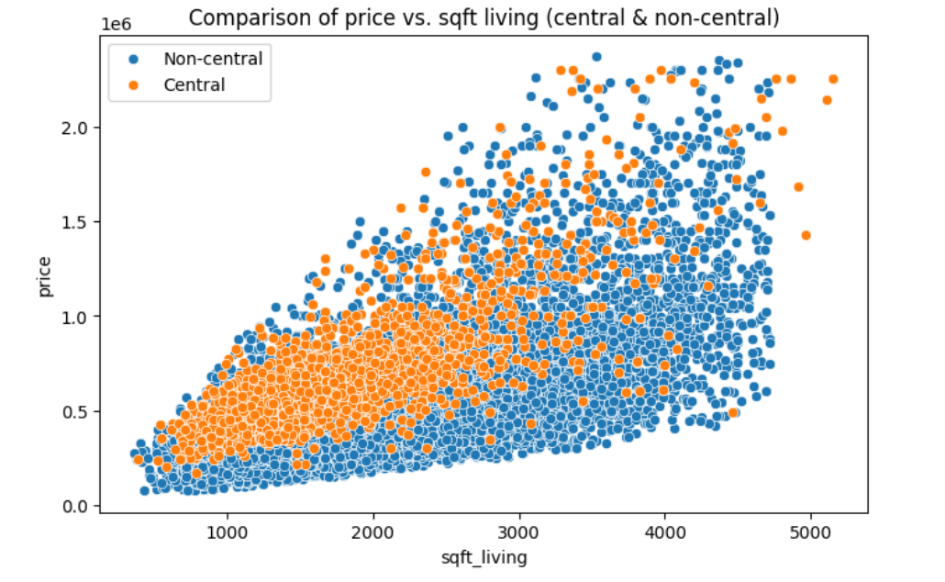
Comparison of price per sqft in central vs. country

Slide 13
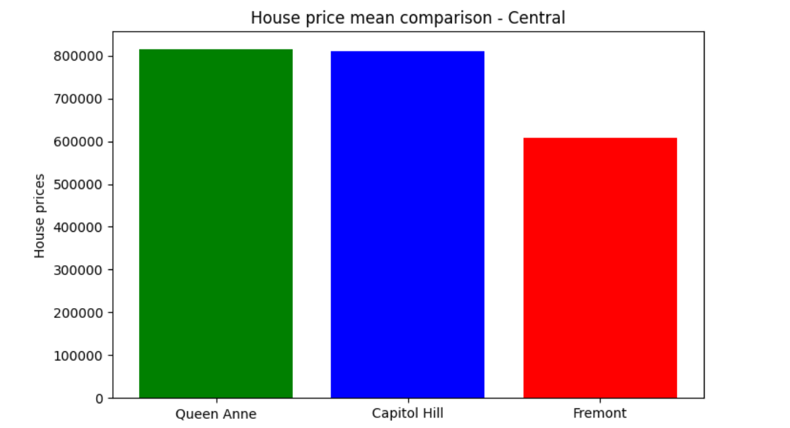
Comparison of avg. house price in central areas

Slide 14
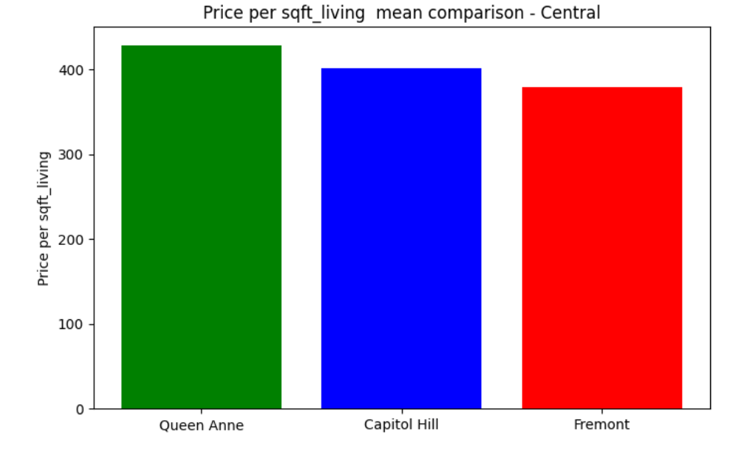
Comparison of price per sqft in central areas

Slide 15
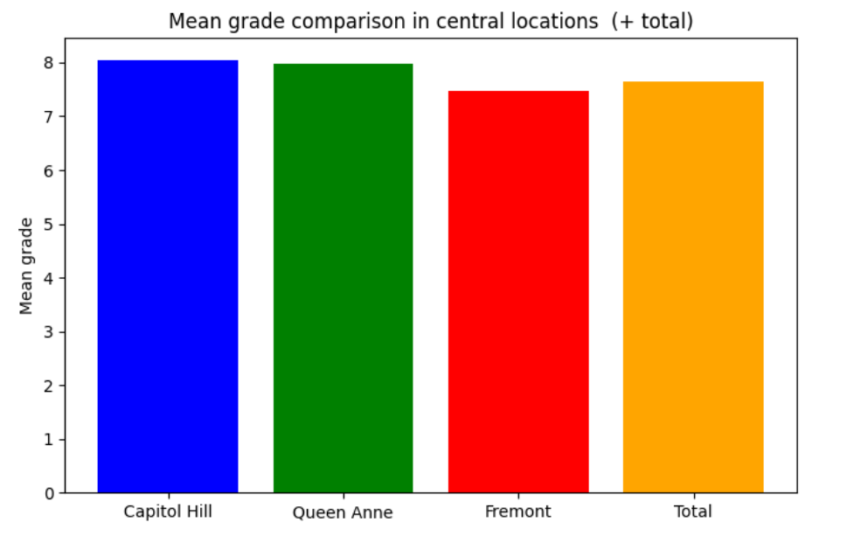
Comparison of avg. grade in central areas

Slide 16
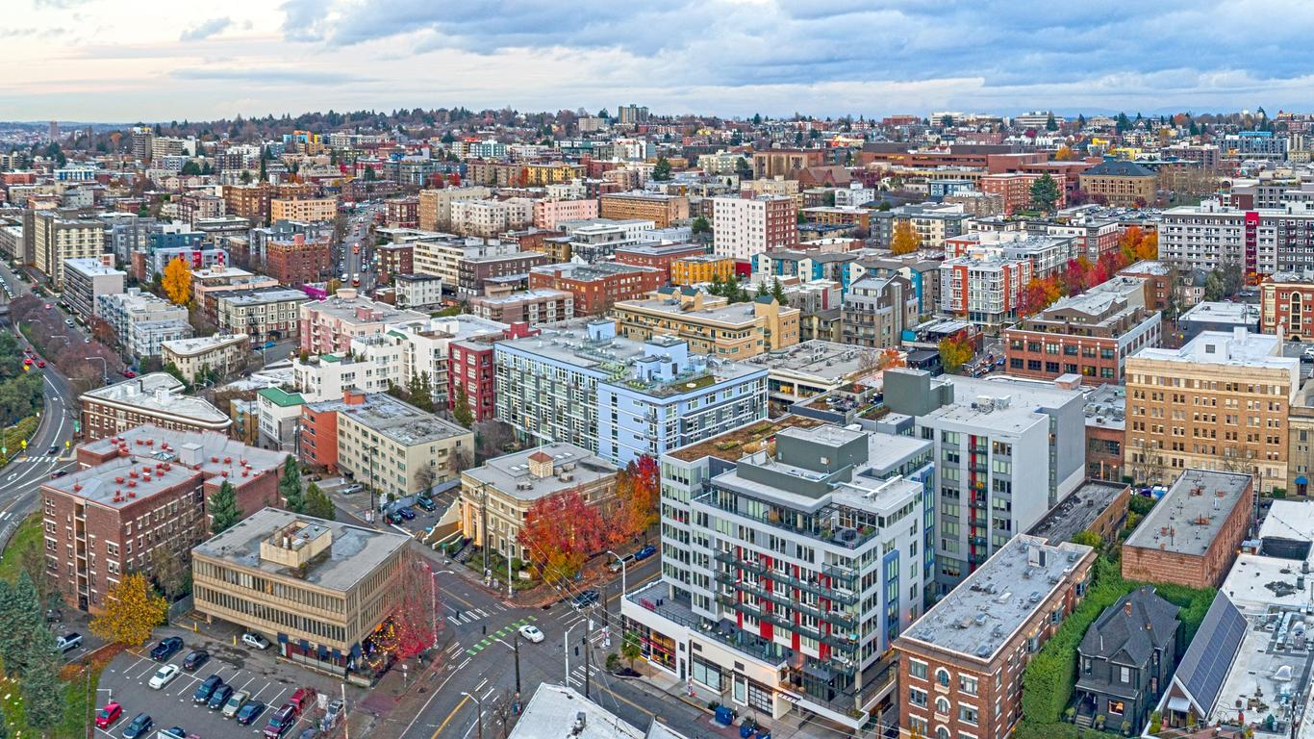
Winner:
Capitol Hill

Slide 17
Requirements for city home
Square feet should be 100 m2 or bigger
Price per sqft should be below avg. in Capitol Hill
Grade should be above average in Capitol Hill
House should be renovated

Slide 18
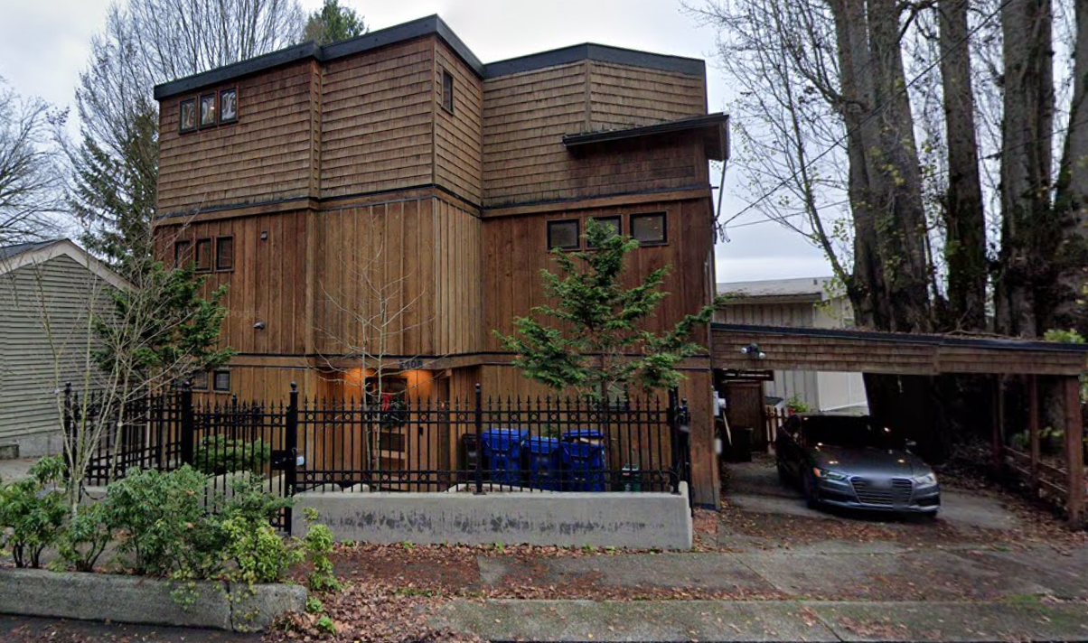
Three options for country house
id | bedrooms | sqft_living | price | sqft_lot | floors | grade | condition | yr_renovated
9828700200 | 4 | 2170 | 831.000 $ | 4000 | 2.0 | 9 | 4 | 2011
4003000053 | 3 | 2250 | 765.000 $ | 9600 | 2.5 | 9 | 4 | 1991
1952200220 | 3 | 2290 | 660.000 $ | 2798 | 3.0 | 9 | 4 | 1983

Slide 19
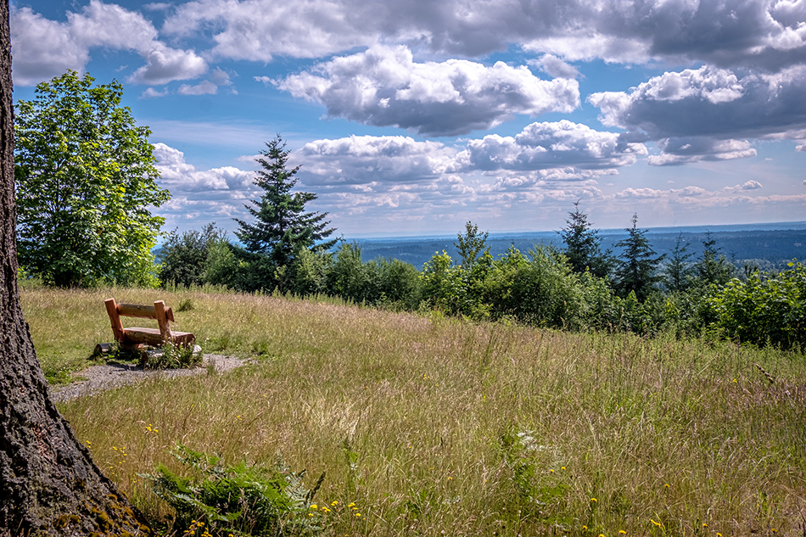
Country home:
Non-renovated and best-timing

Slide 20
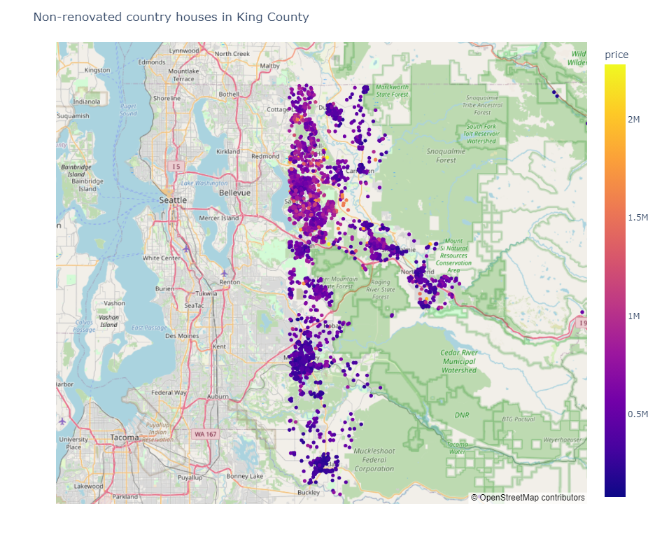
Prices east of lake Sammamish
I consider everything east of lake Sammamish countryside.
(Used longitude)

Slide 21
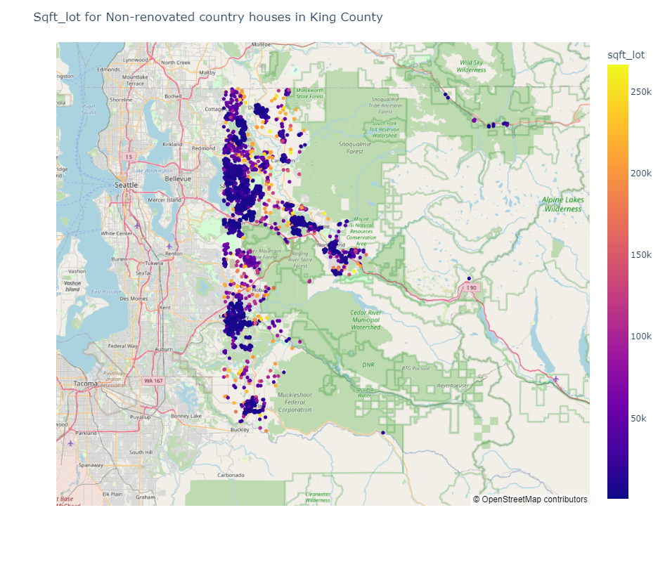
Sqft_lot east of lake Sammamish

Slide 22
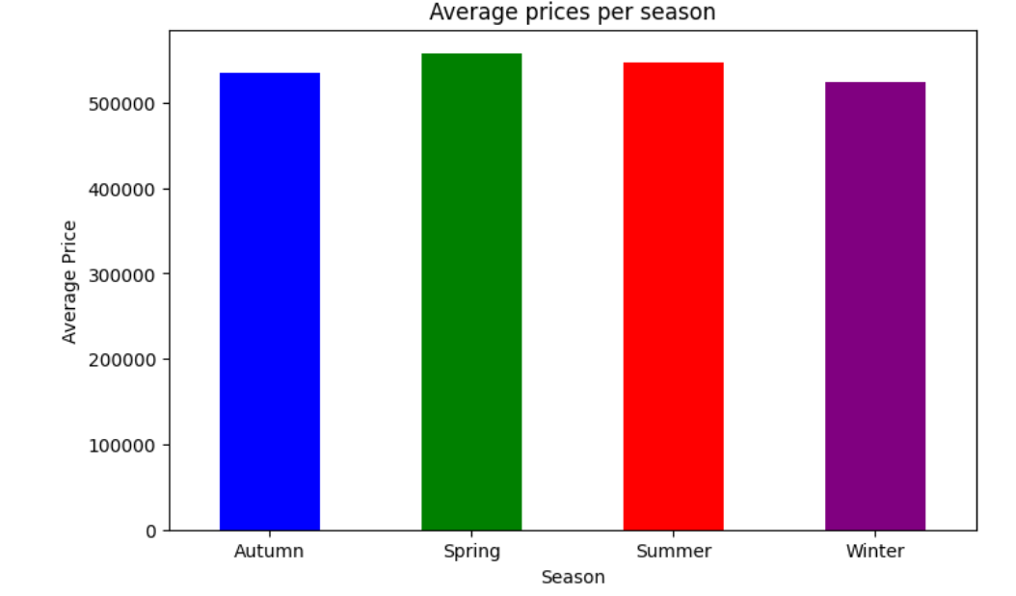
House prices per season
Based on the avg. house prices per season, the client should buy the country house in winter.

Slide 23
Requirements for country house
Price should be below avg. for country houses
Sqft_lot should be above avg. for country houses
Grade should be above avg. grade for country houses
Condition should be at least 4
House should not be renovated

Slide 24
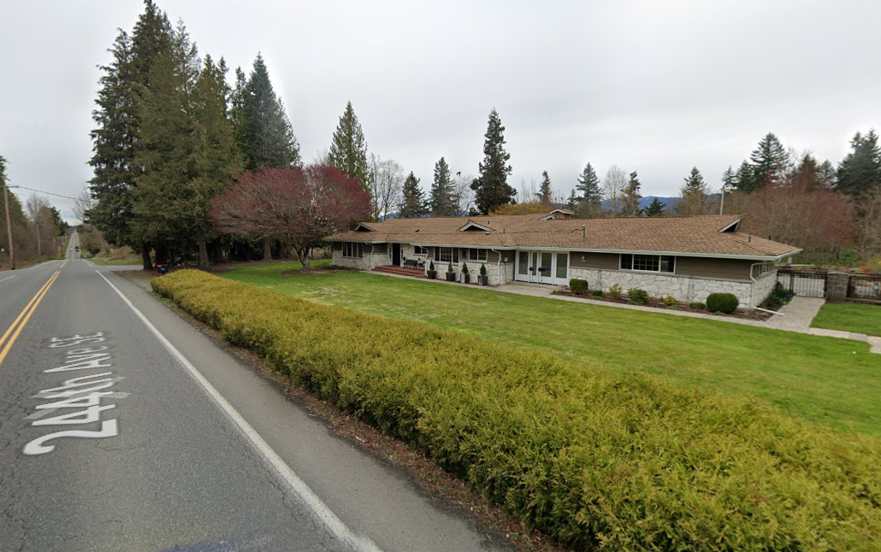
Recommendations - country houses
id | bedrooms | bathrooms | sqft_living | sqft_lot | condition | grade | yr_built | price
2320069014 | 3 | 2 | 2660 | 192099 | 4 | 9 | 1964 | 495000 $
2223069112 | 3 | 2,25 | 2560 | 117176 | 4 | 9 | 1977 | 465000 $
3521069150 | 3 | 2,5 | 2440 | 71002 | 4 | 9 | 1996 | 431000 $
Only 48 minutes drive from Capitol Hill.

Slide 25
Conclusion
Country home price: 495.000 $
City home price: 831.000 $
Price difference: 336.000 $
Country home sqft lot: 192.099
City home sqft lot: 4000
Sqft lot difference: 188.099
Hypothesis confirmed

